Slide 1
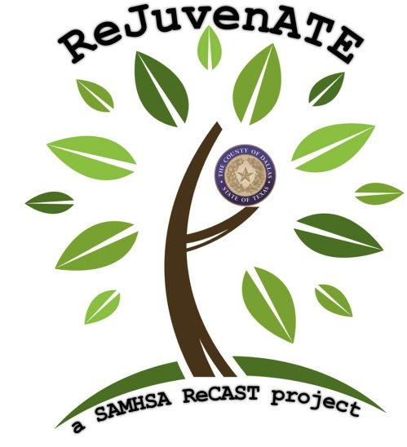
Welcome to Dallas County ReCAST

Slide 2
ReCAST
Resiliency in Communities After Stress and Trauma
Other ReCAST Communities:
Oakland, Chicago, Baltimore, Flint, Minneapolis, St. Louis, Bexar County, Milwaukee, and Baton Rouge

Slide 3
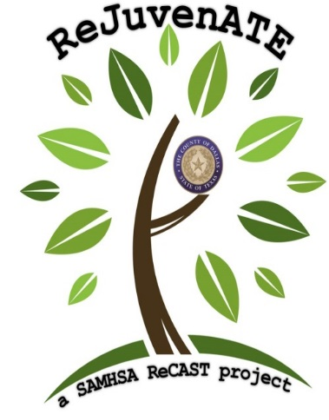
History & Purpose of ReCAST grants
The grants promote resilience and equity through applying evidence-based, violence prevention, and community youth engagement programs. The grants will also help promote access to trauma-informed behavioral health services.

Slide 4
Why Dallas County?
Multiple qualifying events in the last few years
July 7, 2016 (Downtown vigil/rally against police brutality led to attack on police officers)
Death of Jordan Edwards by Balch Springs PD
Attack on Dallas-Fire Rescue Paramedic
Community College Shooting
These events impacted our communities, students, first responders, health systems

Slide 5
What is the Dallas County ReCAST Project?
Dallas County ReJuvenATE
Revitalize Juveniles through Acknowledgement, Training, and Empowerment
Two year project in partnership with local communities

Slide 6
The Dallas County Model
Area of Impact:
75224, 75232, 75237
Characteristics:
Majority-Minority zip codes
30% of households below the FPL
High number of single parent households
Low health insurance rates
Low education levels
Training based outreach
Individuals that come in contact with youth and their families before, during, and after trauma
First responders, health professionals, educators and community based organizations

Slide 7
Community Partnerships
Community Based Organizations
Education Institutions
Government
Healthcare Organizations
Law Enforcement
Philanthropic Organizations
Religious Groups
Youth Organizations
Help us magnify the reach of the project throughout Dallas County
Attend trainings, be active participants
Assist with feedback for the Community Needs Assessment
Make your organizational resources available to the project
Provide feedback to project staff

Slide 8
Developing a Community Strategic Plan
Based on the community needs assessment
Collaborative effort with project leadership, project partners and impacted communities.
Building a better community through effective communication, collaboration, accountability and transparency.
Planning and implementing culturally and linguistically appropriate trainings to develop sustainable community resources.

Slide 9
Next Steps…
Join the Coalition
Designate a staff member
Keep the ReJuvenATE team up to date with what your organization is doing.
Look for follow up emails regarding the Community Needs Assessment, Strategic Plan and Community Training Opportunities
Participate in pre and post evaluation

